Slide 1
Quick Recap
Your meetings, summarized in seconds.
By : Team 2 Bros of Balayya

Slide 2
Agenda
Problem Statement
Project Description
Persona
MVP
Technologies & Algorithm
Project Schedule
Teamwork Agreement
Sprint Retrospective

Slide 3
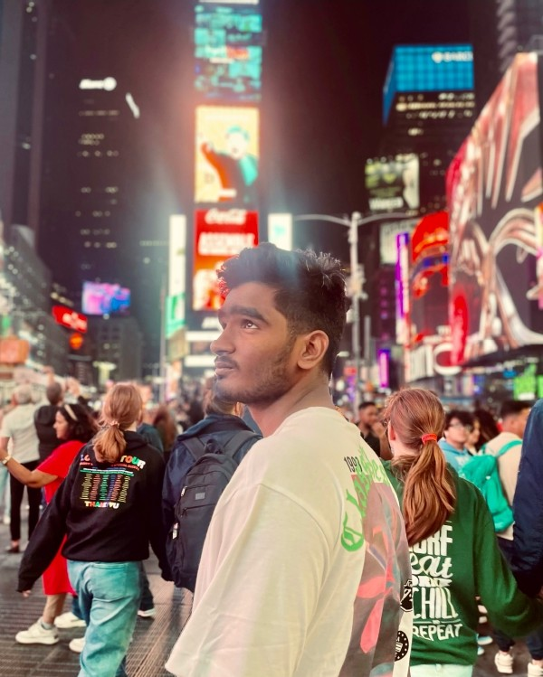

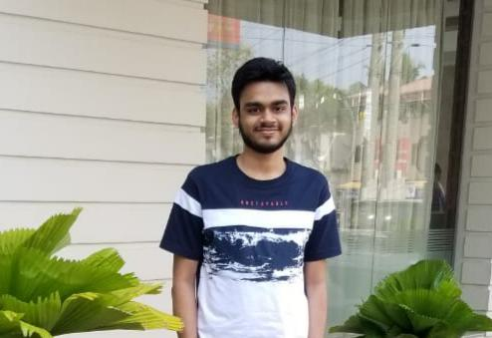
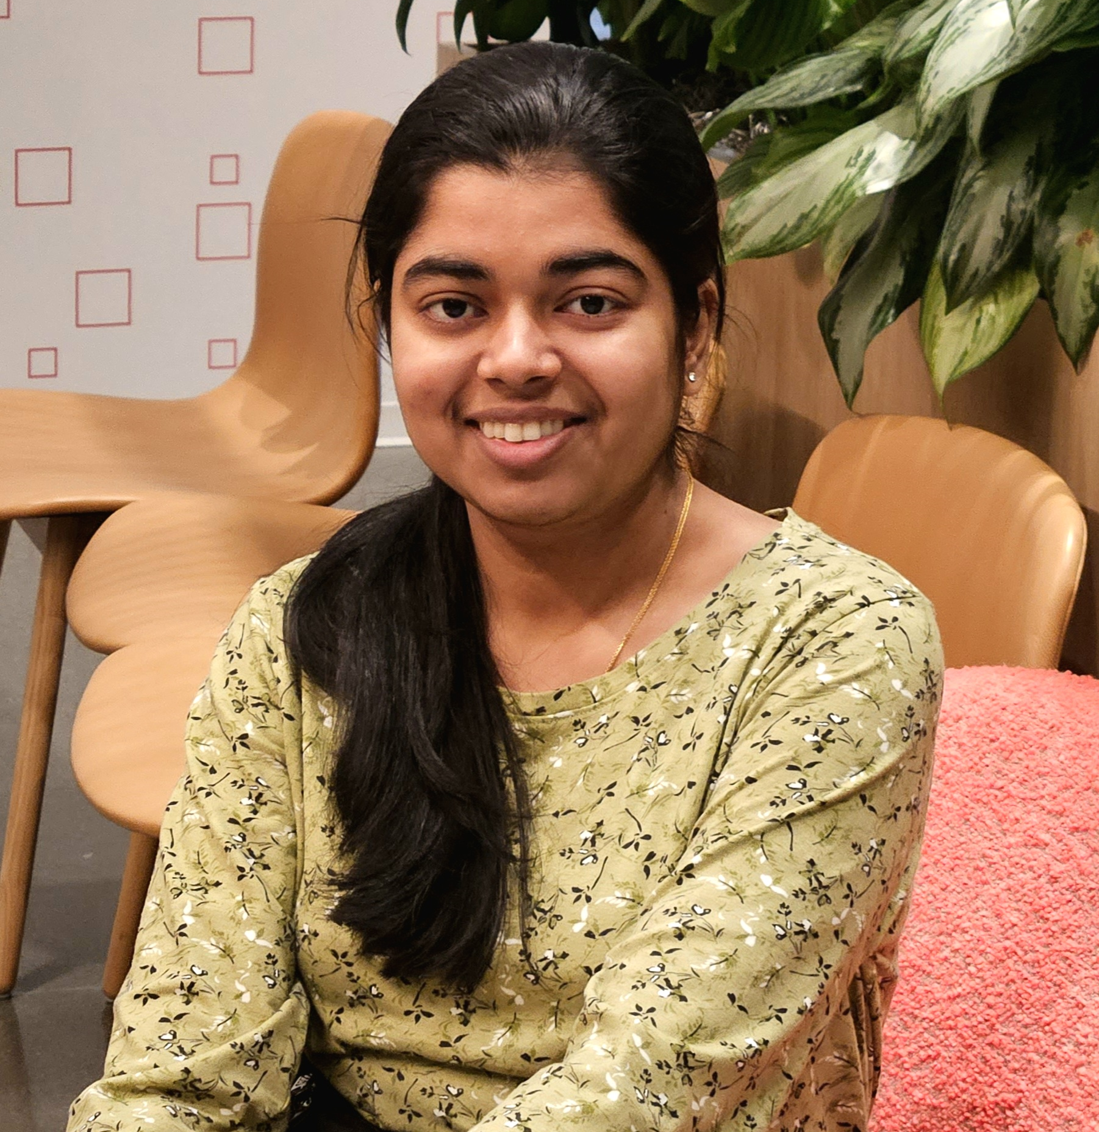
Roles & Responsibilities
Naveen Nayak Team Lead/ Backend Engineer
Navya Nayak ML Engineer/ Scrum Master
Madhu Kiran Frontend Engineer

Slide 4
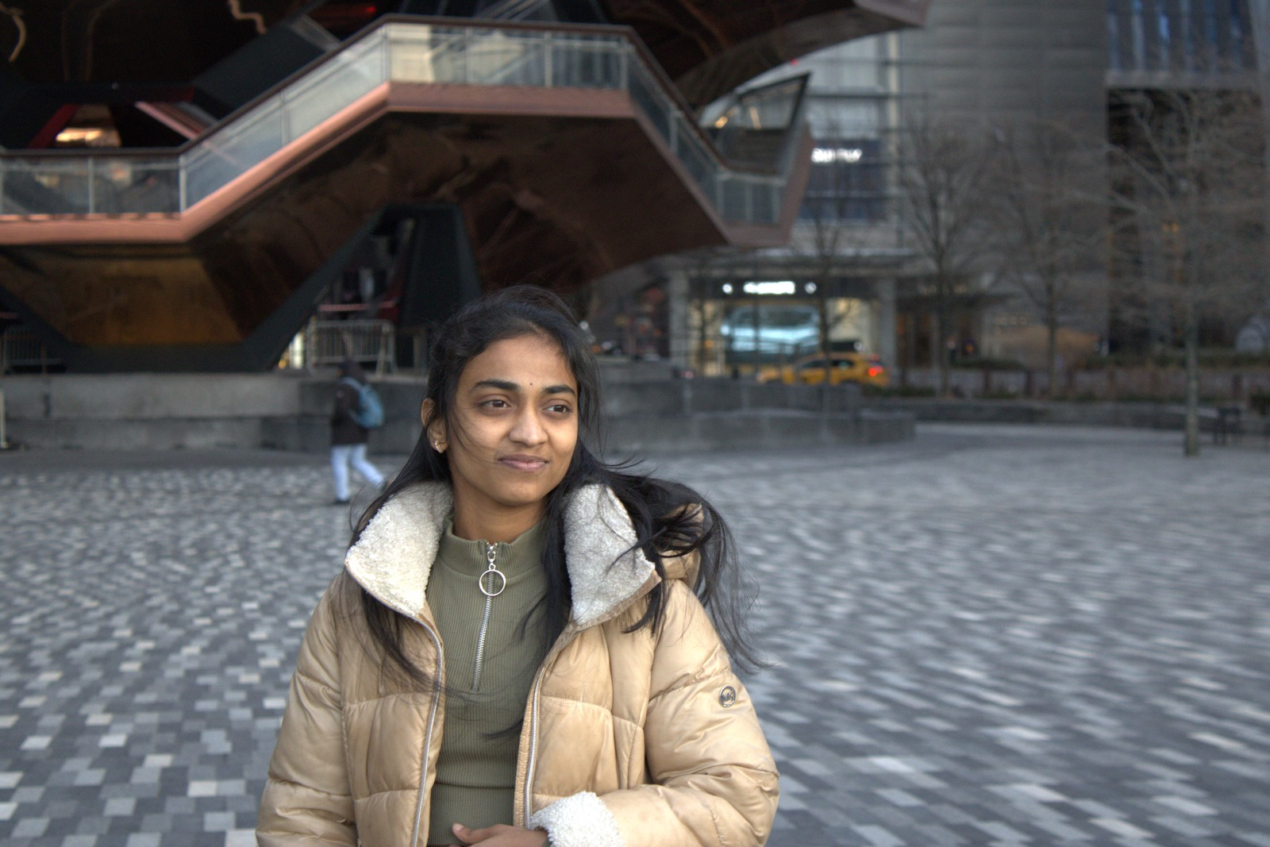
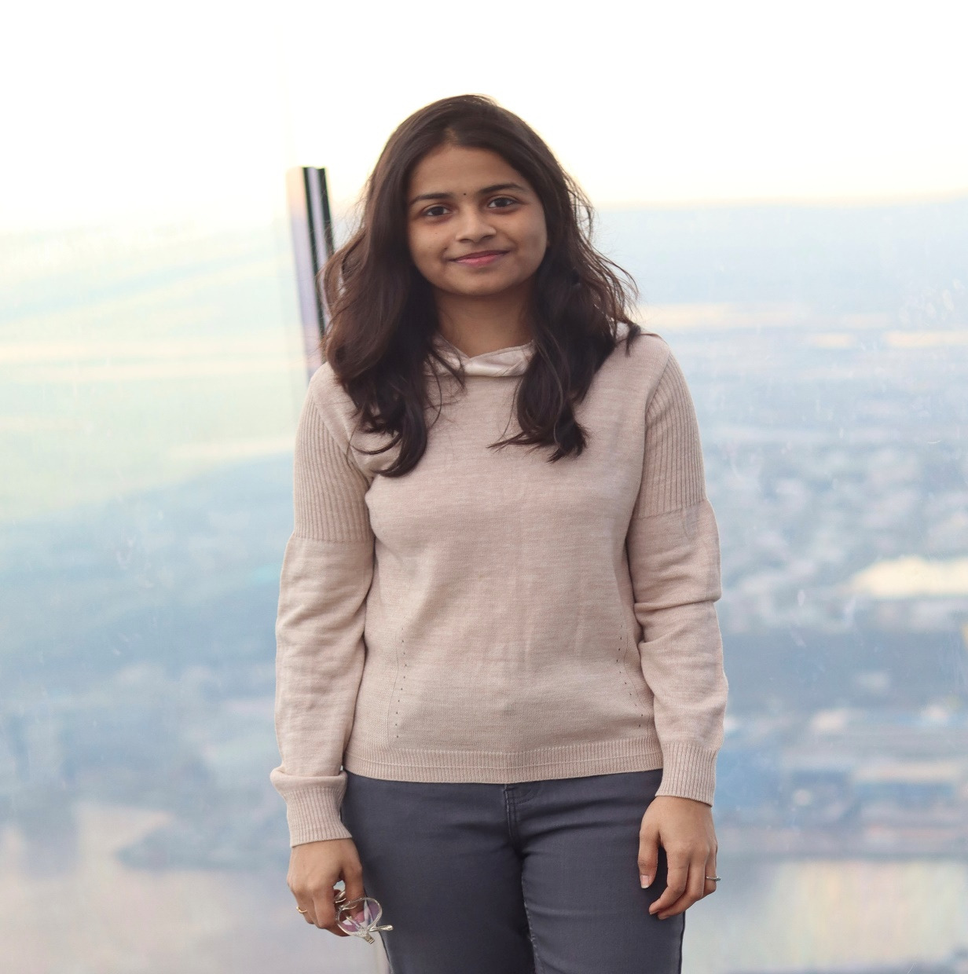
Roles & Responsibilities
Saranya Chandu ML Engineer
Aakruthi Reddy Frontend Engineer

Slide 5
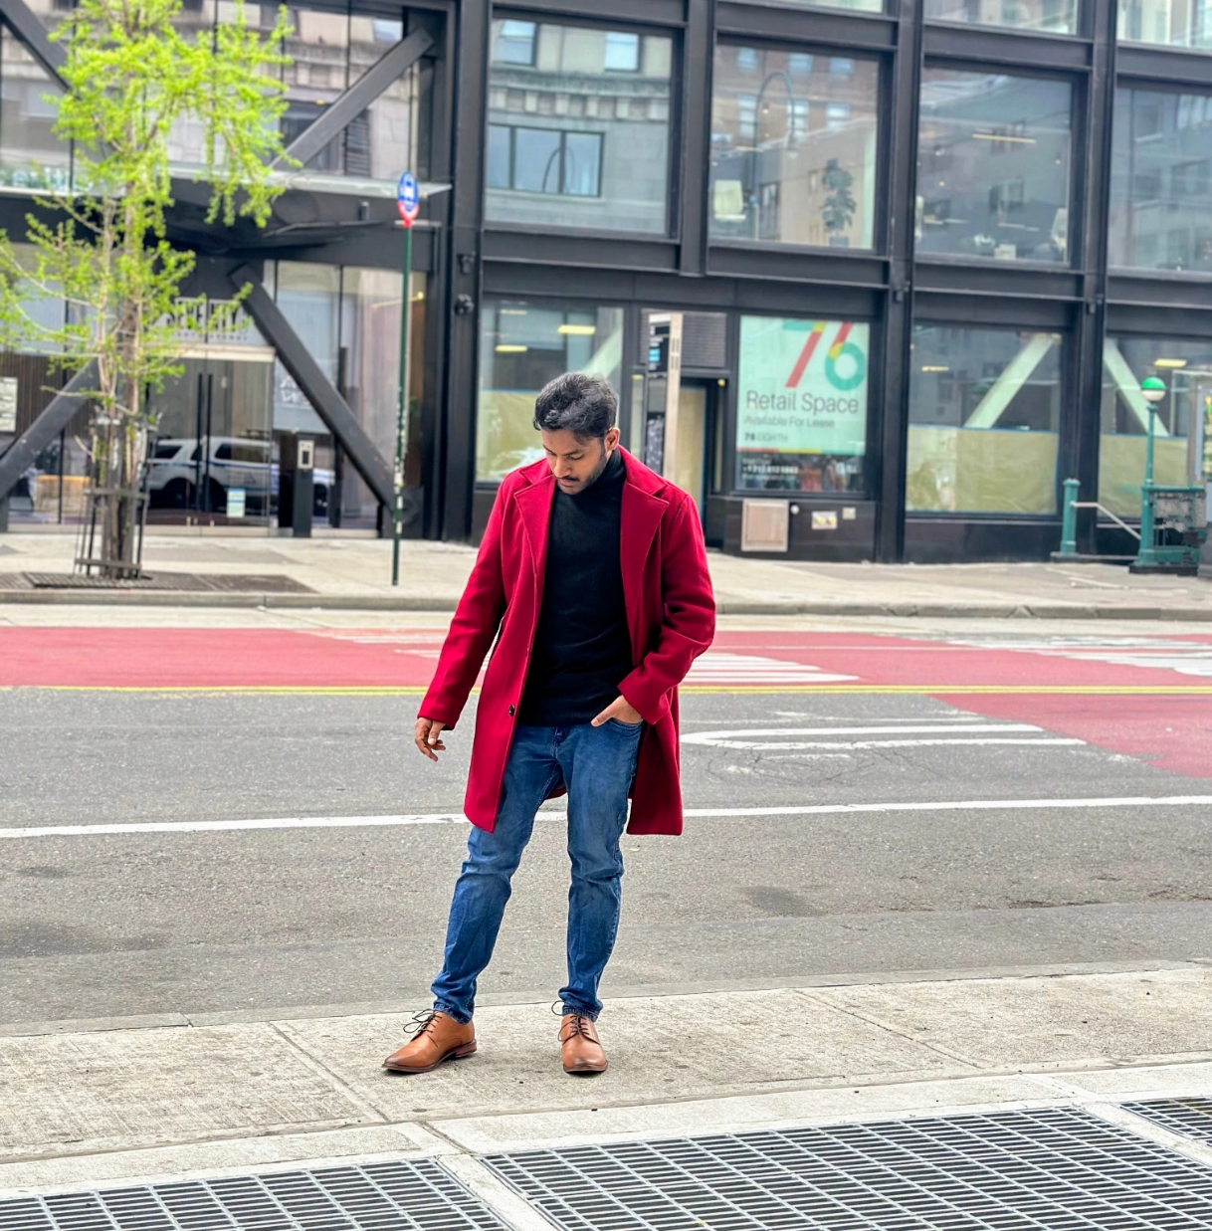
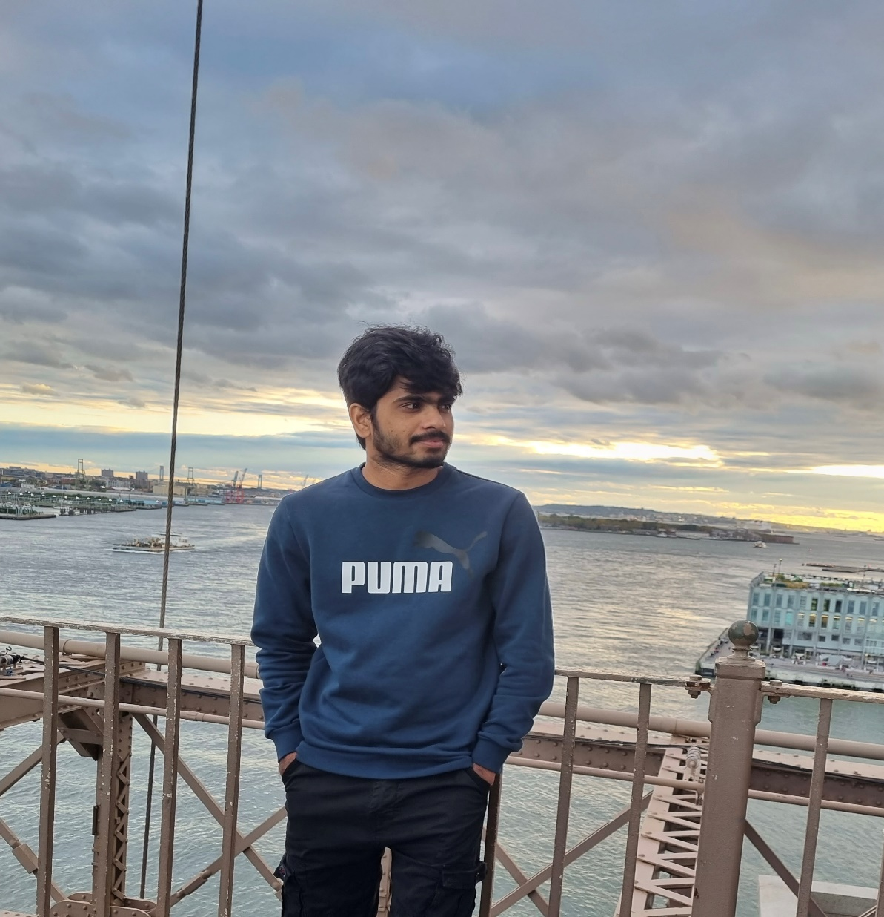
Roles & Responsibilities
Brunai Developer
Vishwas Mamidi Developer/ QA

Slide 6
Meetings are essential, but reviewing recordings and notes is time-consuming and often inefficient. Quick Recap solves this problem by providing personalized, AI-powered summaries of meetings, saving users time and maximizing the value of meeting content.
Problem Statement

Slide 7
Project Description
Web application for enhanced meeting productivity.
Provides personalized summaries of meeting recordings.
Employs natural language processing (NLP) for summary generation.
Highlights the most relevant information based on user profiles.
Enables users to quickly grasp key takeaways without reviewing lengthy recordings.

Slide 8

Persona – Project Manager
Isabelle is a high-level executive at a fast-growing tech company. She's intelligent, driven, and constantly juggling multiple projects and responsibilities.
Challenges:
Attends numerous meetings daily, often back-to-back.
Struggles to recall key decisions, action items, and strategic discussions from past meetings.
Lacks time to review lengthy meeting recordings or detailed notes.
Goals:
Quickly identify action items and delegate tasks effectively.
Make informed decisions based on accurate and concise meeting information.
Reclaim valuable time spent reviewing meeting content.
Name: Isabelle
Age: 48
Gender: Female
Occupation: Project Manager

Slide 9

Persona - Journalist
Lena is an investigative journalist who conducts numerous interviews for her stories. She needs to accurately transcribe and analyze these interviews to extract key information and build her narratives.
Challenges:
Spends countless hours transcribing interviews, which takes away from her research and writing time.
Requires accurate transcriptions to ensure the integrity of her reporting.
Finds it difficult to organize and manage a large number of interview recordings.
Goals:
Quickly and accurately transcribe interviews.
Improve her research and writing workflow..
Efficiently extract key quotes and information.
Name: Lena
Age: 28
Gender: Female
Occupation: Journalist

Slide 10
Persona - Student
Carlos is a highly motivated university student pursuing a demanding degree in engineering. He's dedicated to his studies but often finds himself overwhelmed by the volume of information presented in lectures and seminars.
Challenges:
Struggles to keep up with the fast pace of lectures and take comprehensive notes.
Finds it difficult to identify the most important concepts and takeaways from lectures.
Needs a more efficient way to organize and review lecture material.
Goals:
Easily find specific information discussed in lectures.
Create concise and organized notes from lectures without having to rewatch everything.
Improve his overall learning efficiency and academic performance.
Name: Carlos
Age: 22
Gender: Male
Occupation: Engineering Student

Slide 11
Upload audio/video files
Automatic transcription via speech-to-text
Basic user profiles (role, interests)
Personalized summaries based on user profiles
Core summarization algorithm
User-friendly web interface.
MVP Product

Slide 12






Technologies
REACT
JavaScript
Python
Firebase
Jira
GitHub

Slide 13





Workflow
Upload
Speech to text
Personalization
Summarization
Display

Slide 14
Project Schedule
Sprint planning call scheduled at the beginning of every sprint cycle.
Team meetings scheduled 3 times a week.
Sprint retrospective call scheduled at the end of every sprint cycle.
Sprint 0 Feb 11
Sprint 1 Mar 11
Sprint 2 Apr 8
Sprint 3 Apr 29

Slide 15
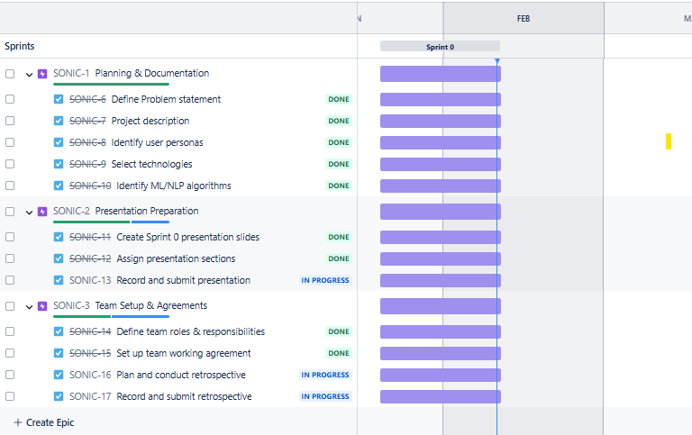
Jira Workflow

Slide 16
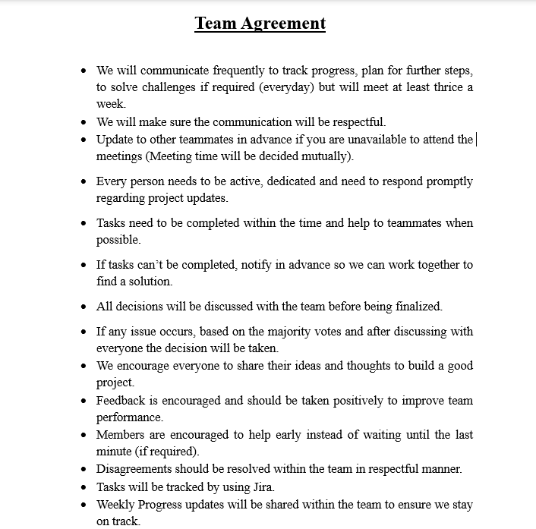
Team Working Agreement

Slide 17
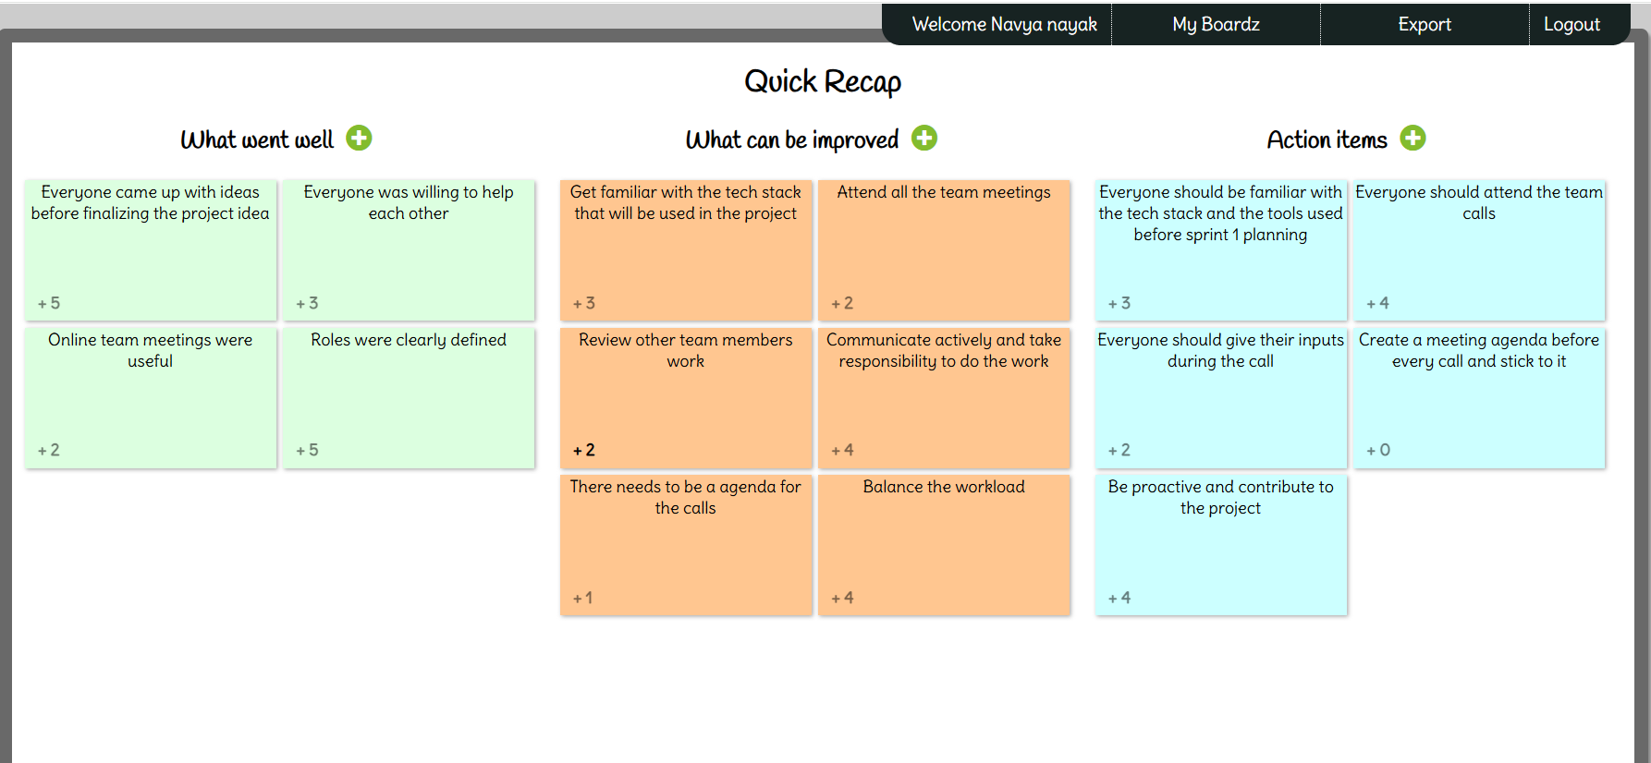
Sprint Retrospective

Slide 18
Wiki page Link
To see our progress visit the wiki page below:
https://github.com/htmw/2025S-Bros-of-Balayya/wiki

Slide 19
Thank You

